Slide 1
RCS Technical Architecture Insight

Slide 2
Part 1
  Architecture Overview

Slide 3
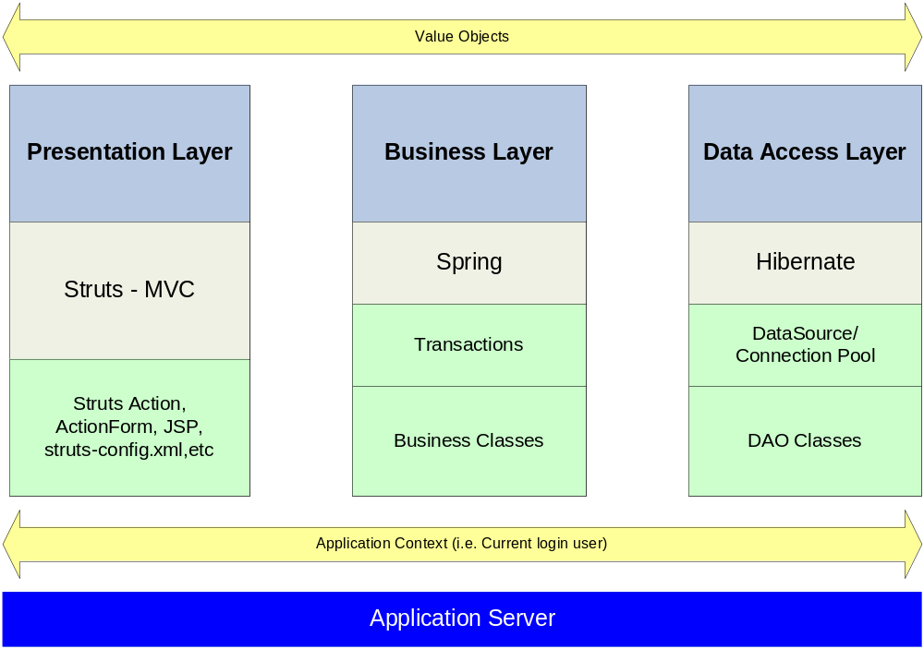
Architecture Overview

Slide 4
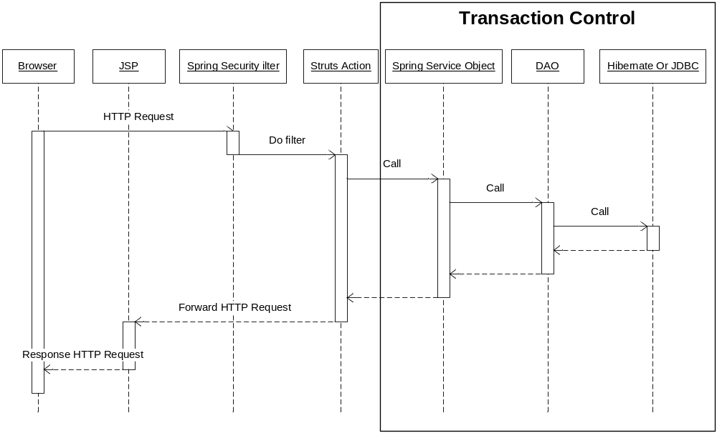
Typical Program Flow
      Typical Program Flow

Slide 5
Technologies
  Struts 1.2.9
  Spring 2.5
  - IOC
  - Transaction Management
  - Spring Security
  Hibernate 3.0
  jBPMs – Workflow Engine
  Drools – Rule Engine
  ValueList – DataGrid (http://valuelist.sourceforge.net/)
  - Pagination
  - Sorting
  - Data Export

Slide 6
Part 2
  Presentation Layer

Slide 7
Struts 1.x
Before learning Struts, make sure you understand:
Servlet
  Servlet URL mapping
  Relationship between Servlet and JSP
  RequestDispatcher.forward() VS response.sendRedirect()
request.getAttribute() and setAttribute()
Request scope VS Session scope
BeanUtil

Slide 8
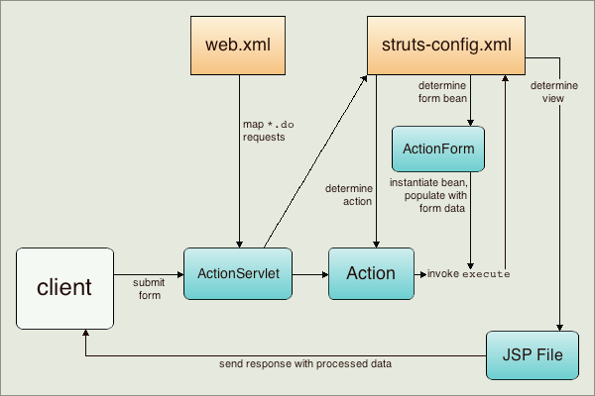
Struts 1.x Overview
Struts Overview

Slide 9
web.xml
<servlet>
<servlet-name>struts</servlet-name>
<servlet-class>org.apache.struts.action.ActionServlet</servlet-class>
<init-param>
<param-name>config</param-name>
<param-value>/WEB-INF/struts-config.xml</param-value>
</init-param>
</servlet>
<servlet-mapping>
<servlet-name>struts</servlet-name>
<url-pattern>*.do</url-pattern>
</servlet-mapping>
All requests ended with .do(e.g. /claims/listClient.do) will be routed to ActionServlet. ActionServlet will dispatch the request to corresponding Action for processing.

Slide 10
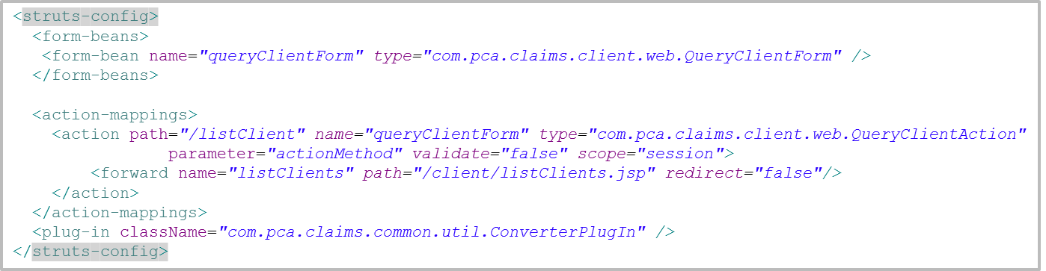
struts-config.xml
<form-bean name=“queryClientForm”..>: session.setAttribute(“queryClientForm”, form)
<action path=“/listClient”…>: /claims/listClient.do will be routed to this Action
<action … parameter=“actionMethod”…>: <input type="hidden" name="actionMethod" value=“doQuery">
<action … scope=“session”>: form bean will be put in Session via session.setAttribute(). If scope=“request”, request.setAttribute() will be used instead
<forward … redirect=“false”>: Forward to target url using RequestDispatcher.forward() instead of response.sendRedirect()
<plug-in className="com.pca.claims.common.util.ConverterPlugIn" />: Convert data type when populating form bean. E.g. convert string “1/1/2015” to java.util.Date object

Slide 11
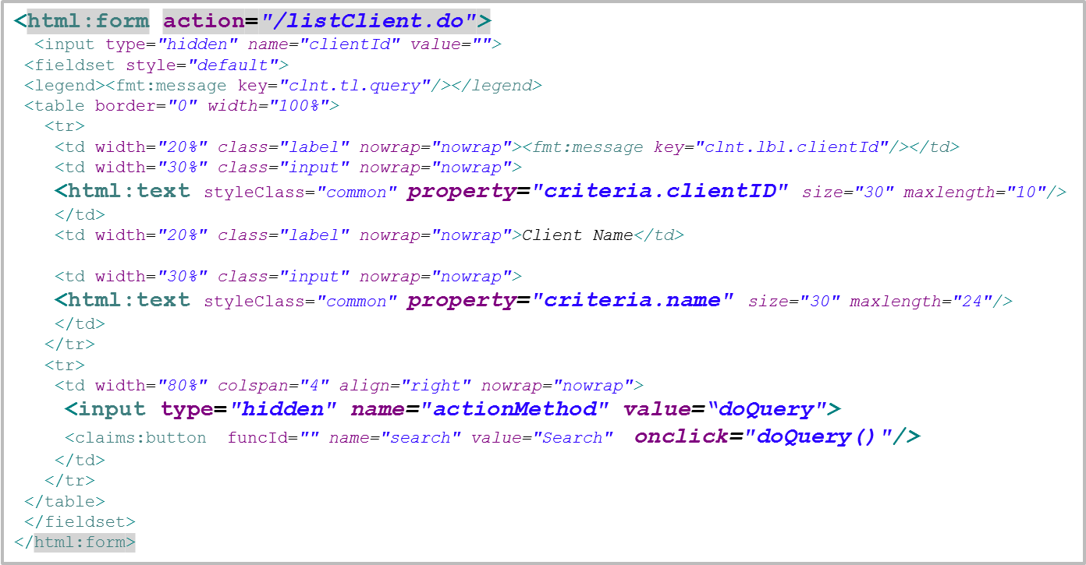
JSP
Map to <action-mappings>
The text box is bounded to form bean property criteria.clientID
Will call the method doQuery() of the Action class

Slide 12
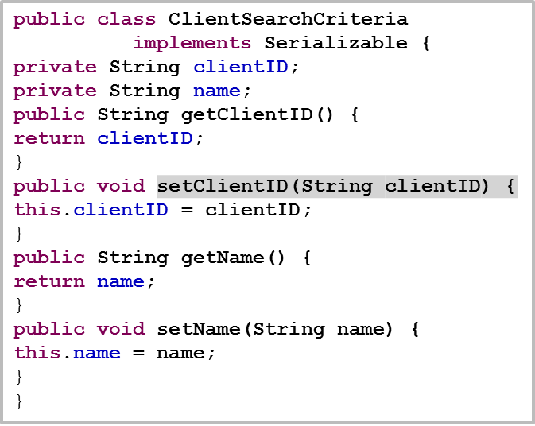
Form Bean
public class QueryClientForm extends ActionForm{
private ClientSearchCriteria criteria = new ClientSearchCriteria();
public QueryClientForm() {
}
public ClientSearchCriteria getCriteria() {
return criteria;
}
public void setCriteria(ClientSearchCriteria criteria) {
this.criteria = criteria;
}
}

Slide 13
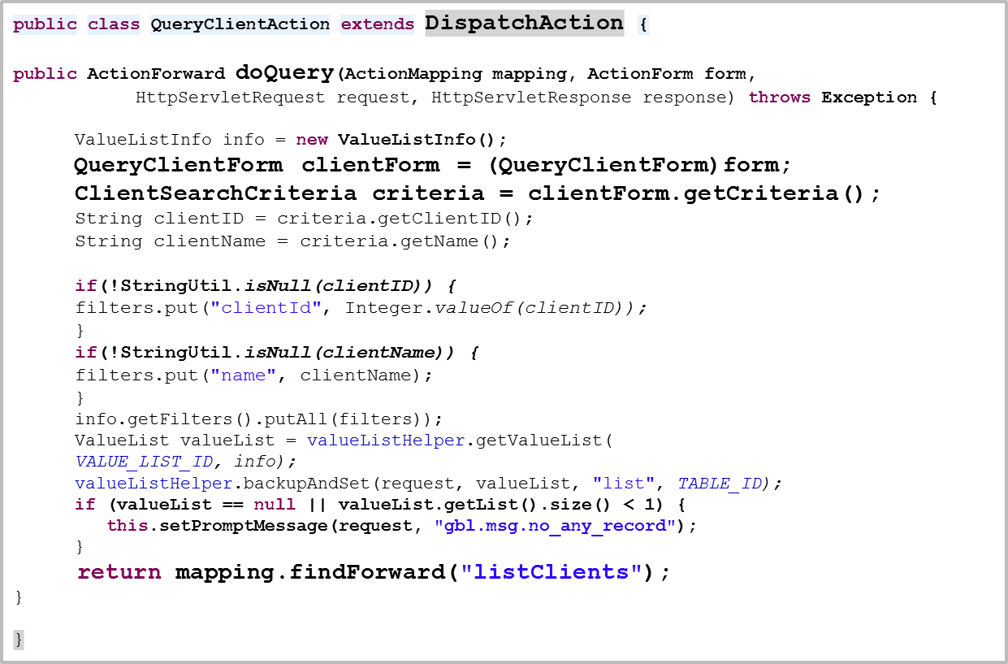
Action

Slide 14
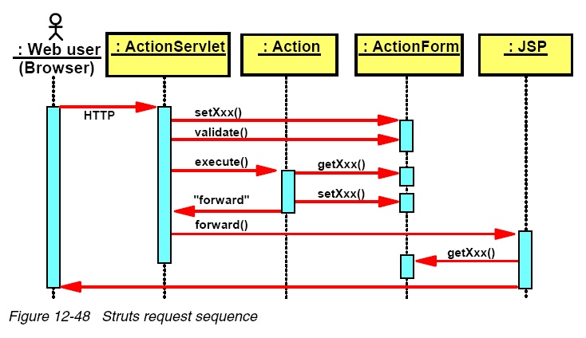
Struts Flow
Struts request handling

Slide 15
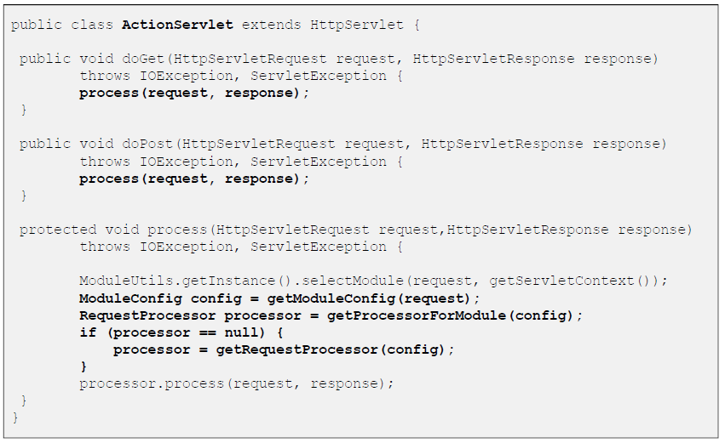
ActionServlet

Slide 16
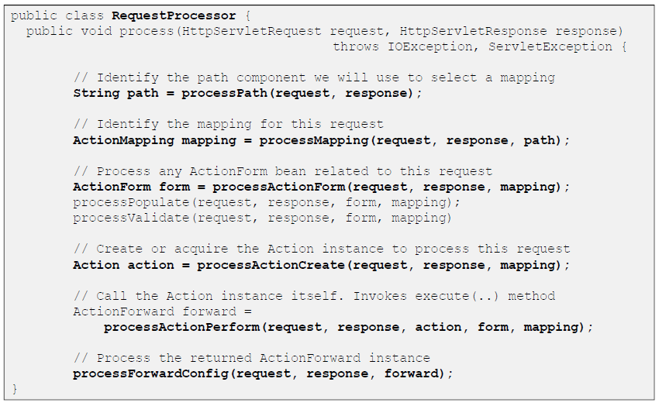
RequestProcessor

Slide 17
FormBean Process
FormBean lifecycle invoked by the RequestProcessor:
1. Retrieve or Create Form Bean associated with Action
2. “Store” Form Bean in appropriate scope (request or session)
- request.setAttribute()
- session.setAttribute()
3. Reset the properties of the Form Bean
4. Populate the properties of the Form Bean
5. Validate the properties of the Form Bean
6. Pass Form Bean to Action

Slide 18
Check Point
What is the common ground among ActionServlet, Action and JSP?
How to use EL expression to access form bean?

Slide 19
Struts HTML Tags
Struts HTML Tags
<html:message key="thekey"/> | Looks up the message corresponding to the given key in the message resources and displays it.
<html:password property="prop" size="10"/> | Tag creates the password field. The string is stored in the property named prop in the form bean.
<html:text property="text1" size="5"/> | Tag creates the text field. The string is retrieved from and later stored in the property named text1 in the form bean.
<html:submit>Submit</html:submit> | Tag creates a submit button with the provided content as the button text.
<html:reset>Reset</html:reset> | Tag creates a reset button with the provided content as the button text.
<html:errors/> | Tag prints all the available error on the page.
<html:file property="fileSelectionBox"/> | Tag creates the file upload element on the form. The property must be of the type org.apache.struts.upload.FormFile.
<html:checkbox property="myCheckBox"/> | Tag creates check box on the form.
<html:hidden property="hiddenfield"/> | Tag creates the hidden html element on the form.
<html:radio value="abc" property="myCheckBox"/> | Tag creates the check box on the form.
<html:select multiple="true" property="selectBox"> | Tag creates list box on the form. The property selectBox must be an array of supported data-types, and the user may select several entries. Use <html:options> to specify the entries.
<html:textarea property="myTextArea" value="Hello Struts" /> | Tag creates the text area on the form.
<html:form action="/Address" method="post"> | Tag is used to create the HTML Form for posting the data on the server.
<html:base/> | Tag generates the base tag. <BASE ...> tells the browser to pretend that the current page is located at some URL other than where the browser found it. Any relative reference will be calculated from the URL given by <BASE HREF="..."> instead of the actual URL. <BASE ...> goes in the <HEAD> section.
<html:html> | Tag renders an HTML <html> Element.

Slide 20
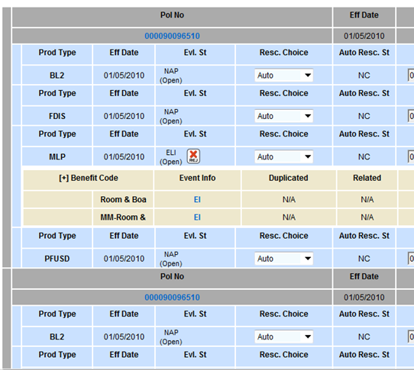
Struts Nested Tag
It's all about nesting beans...
Example
evalulationFormBean
-- policyList (ArrayList <Policy>)
-- productList (ArrayList <Product>)
-- benefitList (ArrayList <Benefit>)

Slide 21
Struts Nested Tag
<nested:nest>
<c:out property="myNestedLevel.propertyOne" />
<c:out property="myNestedLevel.propertyTwo" />
<c:out property="myNestedLevel.propertyThree" />
<nested:nest property="myNestedLevel" >
<nested:write property="propertyOne" />
<nested:write property="propertyTwo" />
<nested:write property="propertyThree" />
</nested:nest >

Slide 22
Struts Nested Tag
<nested:iterate>
<nested:nest property="policyList" >
<nested:iterate id="policy" index="policyIdx">
<nested:hidden name="policy" property="policyId" />
<nested:write name="policy" property="policyNumber" />
</nested:iterate>
</nested:nest>
To understand the basic usage of nested tags, see policyAccountValueAdj.jsp
To explore more advanced feature, see policiesAndRidersInfoNew.jsp
Official reference: http://struts.apache.org/release/1.2.x/userGuide/struts-nested.html

Slide 23
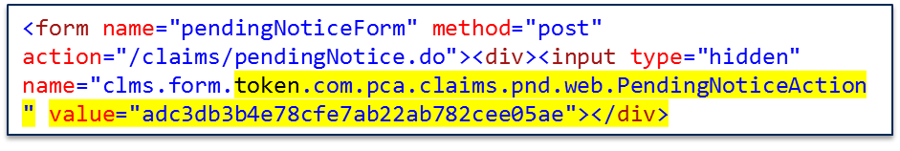
Prevention of duplicated form submission
Step1. Generate token and put in the web page as a hidden field
public ActionForward initCreate(ActionMapping mapping, ActionForm form, HttpServletRequest request, HttpServletResponse response)
throws Exception {
this.removeFormBean(mapping, request);
Client client = new Client();
client.setCountryCode("CHN");
((MaintainClientForm)form).setClient(client);
updateFormBean(mapping, request, form);
initForm(request);
this.saveToken(request);
return mapping.findForward("createClient");
}
String token = generateToken(request);
if (token != null) {
session.setAttribute(
this.tokenName, token); request.setAttribute(
this.tokenName, token);
}

Slide 24
Prevention of duplicated form submission
Step 2. Check if the token is valid by comparing the hidden field value and the value in Session. In case of duplicated submission, the checking will return false.
Step 3. In case needed, do step 1 again.
public ActionForward doSaveNew(ActionMapping mapping, ActionForm form,
HttpServletRequest request, HttpServletResponse response)
throws Exception {
if (this.isTokenValid(request, true)) {
try {
Client client = ((MaintainClientForm)form).getClient();
clientService.createClient(client);
this.setPromptMessage(request, "gbl.msg.save_succeed");
} catch (ApplicationException e) {
this.setErrorMessage(request, e);
}
}
initForm(request);
this.saveToken(request);
return mapping.findForward("createClient");
}

Slide 25
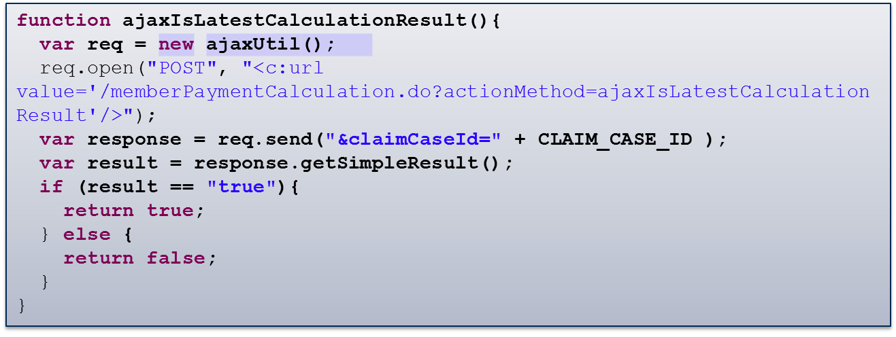
AJAX
In RCS, AJAX is normally used for server side validation, see this
javascript function:
The above code is extracted from memberCalculationMain.jsp

Slide 26
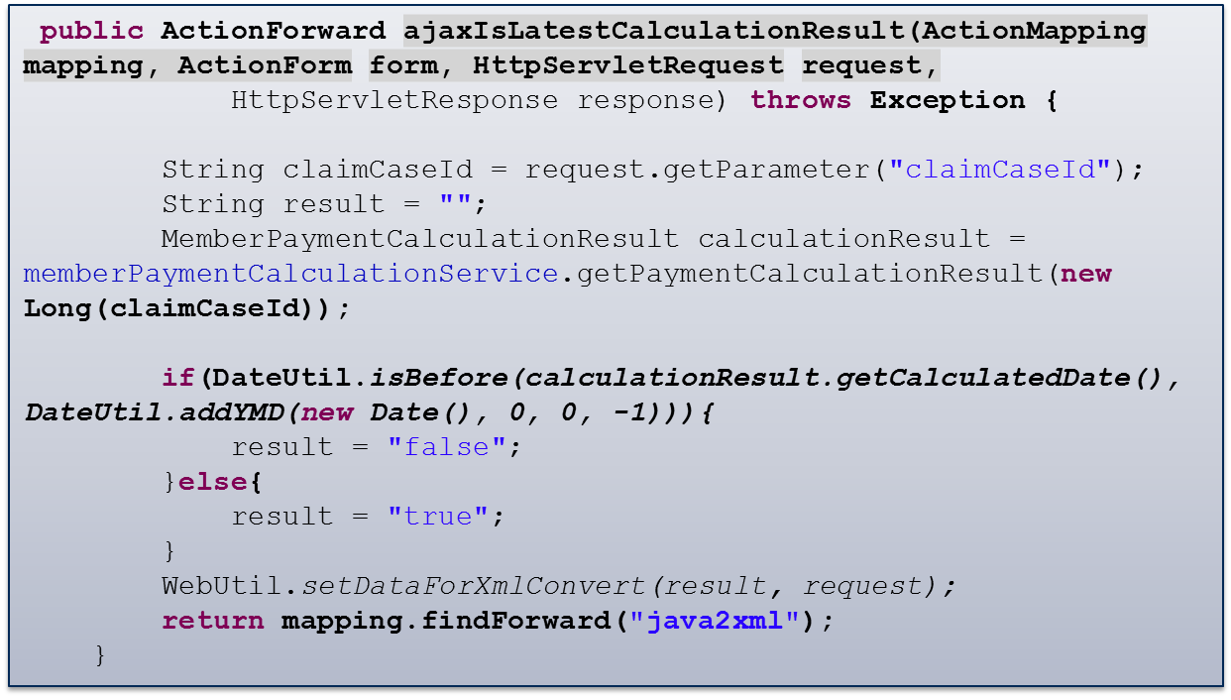
AJAX
The Action method in server side:

Slide 27
AJAX
RCS AJAX utility has built-in exception handling mechanism. When server side throw an exception, the exception message will be shown in a dialog using standard JavaScript alert() function. For detail, refer to ajaxUtil.jsp and WebUtil.java.

Slide 28
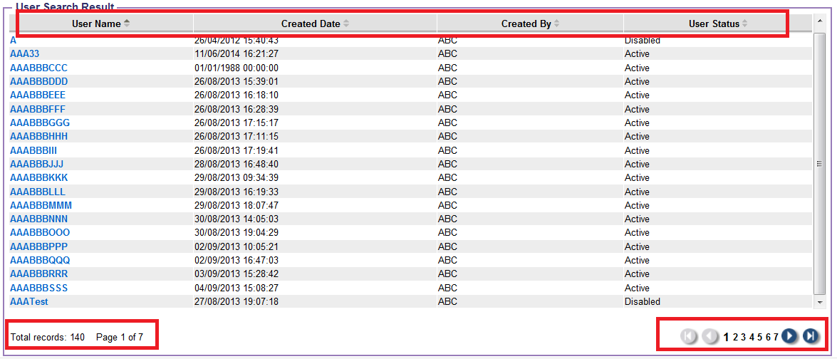
Paging of listing: ValueList
ValueList component can do:
Paging
Sorting
Add a column with check box for selection

Slide 29
Paging of listing: ValueList
Supported Paging Types:
Predefined Hibernate HQL query
Predefined SQL query
Java Collection (e.g. an ArrayList return from DAO)

Slide 30
Paging of listing: ValueList
HQL Paging Example – ValueList Configuration:
appContext_valuelist_definition.xml:
<entry key="clientListHQL">
<bean class="net.mlw.vlh.adapter.hibernate3.HibernateAdapter">
<property name="sessionFactory">
<ref bean="sessionFactory" />
</property>
<property name="defaultNumberPerPage"><value>${valuelist.defaultNumberPerPage}</value></property>
<property name="defaultSortColumn"><value>clientId</value></property>
<property name="defaultSortDirection"><value>asc</value></property>
<property name="hql">
<value>
<![CDATA[
SELECT
new Map(
clientId as clientId,
name as name,
gender as gender,
countryCode as countryCode,
dateOfBirth as dateOfBirth,
lastUpdated as lastUpdated
)
FROM Client
WHERE 1=1
/~clientId: AND clientId={clientId} ~/
/~name: AND name like {name} ~/
/~sortColumn: ORDER BY [sortColumn] [sortDirection] ~/
]]>
</value>
</property>

Slide 31
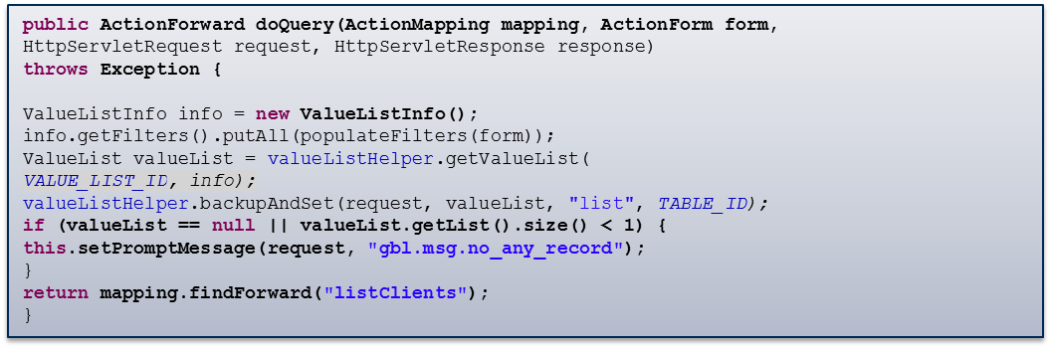
Paging of listing: ValueList
HQL Paging Example – Action method:
QueryClientAction.java

Slide 32
Paging of listing: ValueList
HQL Paging Example – JSP:
listClient.jsp
<table width="100%" class="classicLook" cellspacing="1" cellpadding="1">
<vlh:root id="_vl_client_list" value="list"
url="?" configName="classicLook">
<vlh:addParam name="actionMethod" value="doView" temp="false"></vlh:addParam>
<vlh:header>
<vlh:column titleKey="clnt.lbl.clientId" property="clientId" sortable="asc" attributes=" nowrap='nowrap'"/>
<vlh:column titleKey="clnt.lbl.fname" property="name" sortable="asc" attributes=" nowrap='nowrap'"/>
<vlh:column titleKey="clnt.lbl.dob" property="dateOfBirth" sortable="false" attributes=" nowrap='nowrap'"/>
</vlh:header>
<c:forEach items="${list}" var="vlEntry" varStatus="status">
<c:choose>
<c:when test="${status.count%2==0}">
<c:set var="trCss">odd_row</c:set>
</c:when>
<c:otherwise>
<c:set var="trCss">even_row</c:set>
</c:otherwise>
</c:choose>
<tr class="${trCss}" id="tr${status.count}" ondbclick="rowFocus(tr${status.count})">
<td>${vlEntry.clientId}</td>
<td>${vlEntry.name}</td>
<td><claims:date value="${vlEntry.dateOfBirth}"/></td>
</tr>
</c:forEach>
</table>

Slide 33
Paging of listing: ValueList
Java Collection Paging Example – ValueList Configuration:
appContext_valuelist_definition.xml:
<entry key="duplicatedClients">
<bean class="net.mlw.vlh.adapter.jdbc.dynclass.DefaultDynclassDaoAdapter">
<property name="defaultNumberPerPage"><value>${valuelist.defaultNumberPerPage}</value></property>
</bean>
</entry>

Slide 34
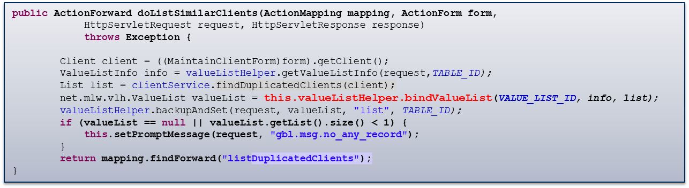
Paging of listing: ValueList
Java Collection Paging Example – Action method:
MaintainClientAction.java :

Slide 35
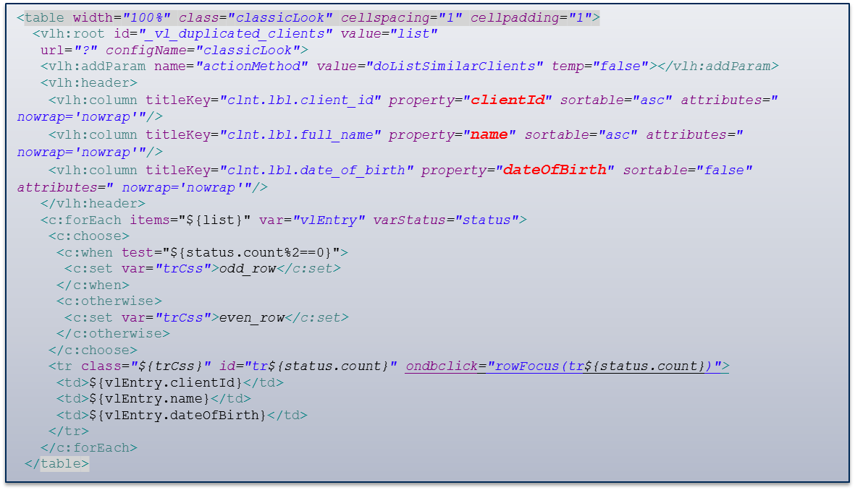
Paging of listing: ValueList
Java Collection Paging Example – JSP:
listDuplicatedClients.jsp

Slide 36
RCS Custom Tags
  <claims:timestampStruts property=“xxx”>
  <claims:numberInputStruts property=“xxx”>
  <claims:button funcId=“”>
  <claims:security funcId=“”>
  <claims:title titleKey=“xx.tl.xxxx”>
  <claims:date value=“xxx”>
  <claims:dateTime value=“xxx”>
  <claims:useConstant>
  <claims:codePicker>
  <claims:jsPostProcess />

Slide 37
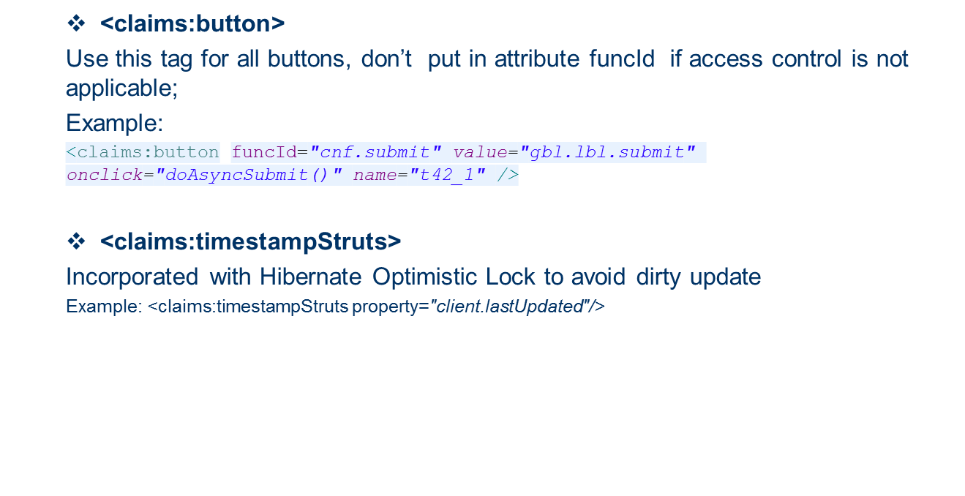
RCS Custom Tags

Slide 38
RCS Custom Tags
  <claims:date> or <claims:dateTime>
  Always use the above tags to output formatted date/dateTime, avoid using <fmt:fmtDate>
  <claims:security funcId=“xxx” granted=“true/false”>
  If attribute ‘granted’ were set to ‘true’, the enclosed content will be rendered when the current user have access right on the given funcId.
  If attribute ‘granted’ were set to ‘false’, the enclosed content will be rendered when the current user have no access right on the given funcId.
  <claims:jsPostProcess />
  Must be put at the end of every page. The main purpose of this tag is to generate the alert() statement to prompt message/error returned from server side.

Slide 39
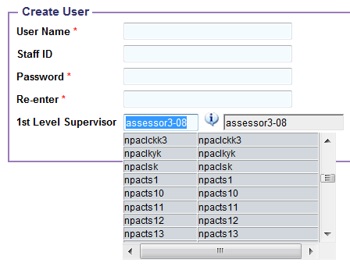
RCS Custom Tags
  <claims:codePicker>

Slide 40
i18n implementation
  Use JSTL<fmt:message> instead of Struts <bean:message>
  Resource files used by JSTL:
  Put under \WebContent\WEB-INF\resources
  One file per each module. GlobalResources.properties for common shared keys among modules
  Auto reload after update without the need of restarting server
  Each file to be declared in applicationContext.xml
  Resource files used by jsptabcontrol: \src\TabTitles.properties

Slide 41
i18n examples for JSP
  Label:
  <fmt:message key="clnt.lbl.client_id"/>
  ValueList column head:
  <vlh:column titleKey="clnt.lbl.dob" …>
  ValueList pagination:
    <fmt:message key="gbl.lbl.pagination">
    <fmt:param><c:out value="${list.valueListInfo.totalNumberOfEntries}" default=""/></fmt:param>
    <fmt:param><c:out value="${list.valueListInfo.pagingPage}" default=""/></fmt:param>
    <fmt:param><c:out value="${list.valueListInfo.totalNumberOfPages}" default=""/></fmt:param>
    </fmt:message>
  Javascript in jsp:
    alert("<fmt:message key="clnt.err.too_many_criteria"/>");
    alert(i18nUtil.getMessage(“<fmt:message key="clnt.err.duplicated_name"/>”, clientName.value));
  Tab Title:
  <jsptabcontrol:tabPage titleKey="clnt.lbl.basic_info" …>
  Drop down list:
<html:option value="Male"> <fmt:message key="clnt.lbl.gender_1"/> </html:option>
<html:option value="Female“><fmt:message key="clnt.lbl.gender_2"/> </html:option>

Slide 42
i18n examples for Java Class
  Prompt message from Action:
  this.setPromptMessage(request, "gbl.msg.no_any_record");
  Exception message:
  throw new BusinessException("clnt.err.duplicated_client",
    new Object[]{String.valueOf(duplicatedClient.getClientId())});
  Retrieve message explicitly:
    String systemName = MessageSourceUtil.getMessage(MessageKeys.SYSTEM_NAME);

Slide 43
Exercise 1
  1. Explore the source code of claimsTraining:
  a. Client List: http://localhost:8080/claimsTraining/listClient.do?actionMethod=init
  b. Add Client: http://localhost:8080/claimsTraining/maintainClient.do?actionMethod=initCreate
  c. Update Client: http://localhost:8080/claimsTraining/maintainClient.do?actionMethod=initUpdate
  2. Enhance the system:
  2.1 Modify the “Client List” screen:
  a. Show all clients by default, instead of showing an empty list;
  b. Change the number of records per page to 5;
  c. Add a new search criteria “Country”, also, add the “Country” as a new column;
  d. Change the default sorting column to “Country”;
  2.2. Modify “Client list”, “Add Client” and “Update Client” screens:
  a. Modify “Client List” screen:
  i. Put in an “Add” button, linking to “Add Client” screen.
  ii. Add a new column in the list, put in hyper links below:
  - Update: link to “Update Client” screen
  - Delete: Delete the current client and refresh the list
  b. Modify “Add Client” screen, after saving a new client, redirect to “Client List” screen.
  c. Modify “Update Client” screen:
  i. Remove the search criteria section;
  ii. After update or delete, redirect to “Client List” screen;

Slide 44
Part 3
  Business Layer

Slide 45
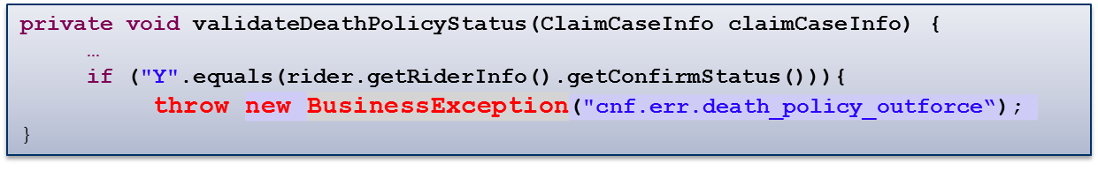
Business Exception
Use general exception class to report business exception, for example:
Make sure <claims:jsPostProcess> tag is put at the end of JSP, then the exception will be shown in the screen.

Slide 46
Business Date
Rather than system date relying on Operating System, RCS exploits OS-independent “business date”, which is configurable within RCS application.
Business date can be configured as:
Centralized biz date stored in table SYSINFO
User level specific biz date stored in user table
There are different modes of retrieving business date, which is controlled
by parameter bizDateRetrievingMode in claims.properties:
0 - always load the biz date from table SYSINFO
1 - load user-level biz date at first. If not specified, load from table SYSINFO
2 - load user-level biz date at first. If not specified, load machine system date.
3 - always load machine system date

Slide 47
Business Date
Biz date can be retrieved via BizDateUtil.getBusinessDate().
Example fields which should be set with biz date:
Registered Date
Approved Date
Rejected Date
Example fields which should be set with OS system date:
Last Modified Date
Created Date

Slide 48
AppContext
AppContext.getUserId() – user name
AppContext.getUserName() – user name
AppContext.getUserDesc() – user’s full name
AppContext retrieves user information through Spring Security utility SecurityContextHolder.getContext(), which in turn uses ThreadLocal to store the context.
AppContext can be invoked anywhere after the filter chain have been gone through, which means the user info can be retrieved in Action, Service, as well as DAO.

Slide 49
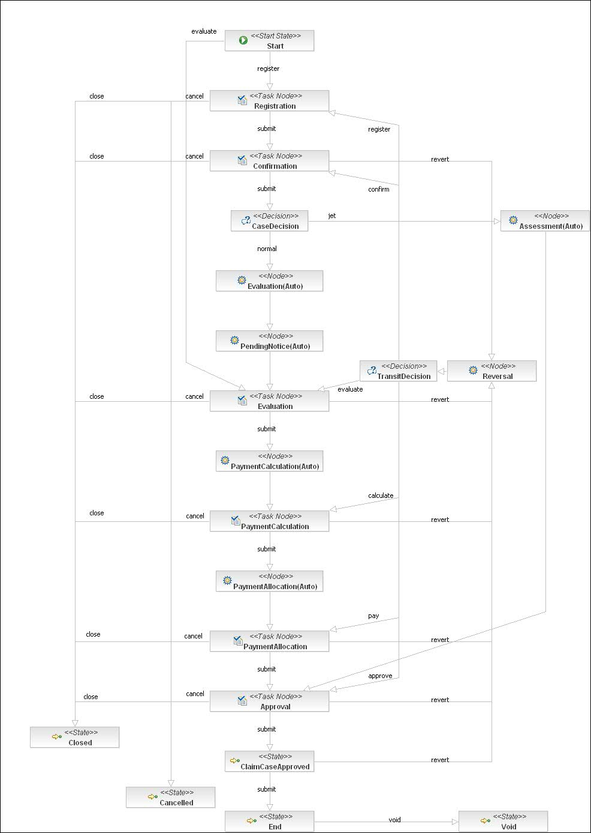
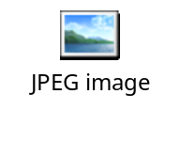
WorkFlow Engine: JBPM
Click to see the original picture

Slide 50
JBPM – Key Concepts
Process instance: A process instance is one execution of a process definition.
Token: A token is one path of execution. A token is the runtime concept that maintains a pointer to a node in the graph. When a process instance is created, a token is created for the main path of execution. This token is called the process instance's root token and is positioned in the process definition's start state.
Signal: A signal instructs a token to continue graph execution by transition out of a node.
Node: Nodes are responsible for the continuation of a graph execution. When a token enters a node, the node executes. A node that does not propagate execution is regarded as a state.
Action: Actions are instances of Java code executed when events occur in a process execution. The primary event types are "entering a node," "leaving a node," and "taking a transition."

Slide 51
JBPM – Process Instance
- One process instance per claim case
- Process instance created after registration

Slide 52
JBPM – TaskNode
TaskNode
<task-node name="Confirmation" end-tasks="true">
<event type="task-create">
<action class="org.springmodules.workflow.jbpm31.JbpmHandlerProxy" config-type="bean">
<factoryKey>jbpmConfiguration</factoryKey>
<targetBean>stagePretreatmentAction</targetBean>
</action>
</event>
<task>
<assignment class="org.springmodules.workflow.jbpm31.JbpmHandlerProxy" config-type="bean">
<factoryKey>jbpmConfiguration</factoryKey>
<targetBean>assignmentHandler</targetBean>
</assignment>
</task>
<transition to="CaseDecision" name="submit"></transition>
<transition to="Reversal" name="revert"></transition>
<transition to="Closed" name="close"></transition>
<transition to="Cancelled" name="cancel"></transition>
</task-node>

Slide 53
JBPM – AutoNode
AutoNode
<node name="Evaluation(Auto)">
<event type="node-enter">
<action class="org.springmodules.workflow.jbpm31.JbpmHandlerProxy" config-type="bean">
<factoryKey>jbpmConfiguration</factoryKey>
<targetBean>evaluationAutoAction</targetBean>
</action>
</event>
<transition to="PendingNotice(Auto)"></transition>
</node>

Slide 54
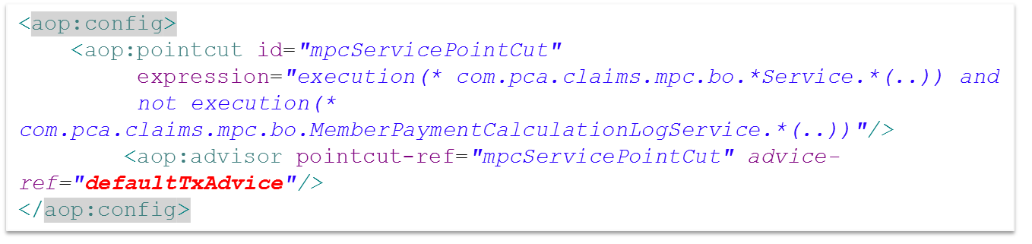
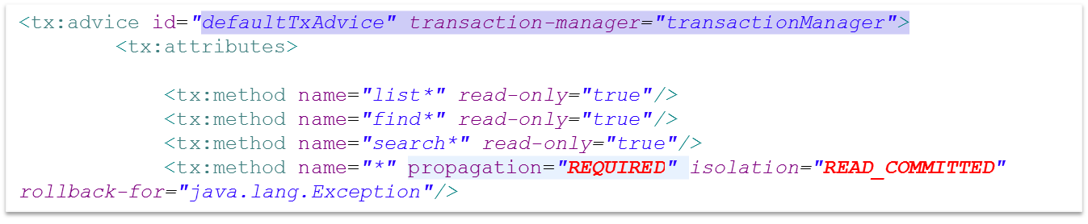
Transaction Management

Slide 55
Transaction Propagation
REQUIRED
REQUIRES_NEW
NESTED
NOT_SUPPORTED
SUPPORTS
The default propagation in RCS is REQUIRED

Slide 56
Transaction Isolation Level
JDBC Isolation Level | DB2 Isolation Level | Means to DB2
TRANSACTION_SERIALIZABLE | Repeatable Read (RR) | The entire table is locked, not just the rows that are retrieved. Until the unit of work completes, no other application can update, delete, or insert a row that would affect the table.
TRANSACTION_REPEATABLE_READ | Read Stability (RS) | – Will keep all qualifying rows locked until the transaction is completed – Does release locks on rows that do not satisfy query predicates – Use for result set stability or when future actions on returned rows may be taken
TRANSACTION_READ_COMMITTED | Cursor Stability (CS) | – Default isolation level – Locks and unlocks each row, 1 at a time (never has 2 locks at once) – Guaranteed to only return data which was committed at the time of the read
TRANSACTION_READ_UNCOMMITTED | Uncommitted Read (UR) | – For read only queries, no record locking – Will see uncommitted changes by other transactions

Slide 57
Transaction Design Consideration
  Keep the transaction as small as possible. Small transaction can be executed in relative short duration, where the locks can be released quickly.
  Avoid conflicting data access in two transactions. The example below might cause deadlock:
  Transaction 1 Transaction 2
Update record A
Update record B
Update record B
Update record A

Slide 58
Part 4
  Data Access Layer

Slide 59
Data Access Layer Overview
One POJO per table
Always use HQL for enquiry
BaseDAO as common utility
ID generator
Optimistic Locking

Slide 60
BaseDAO
Source Code Explore…

Slide 61
Part 5
  Security

Slide 62
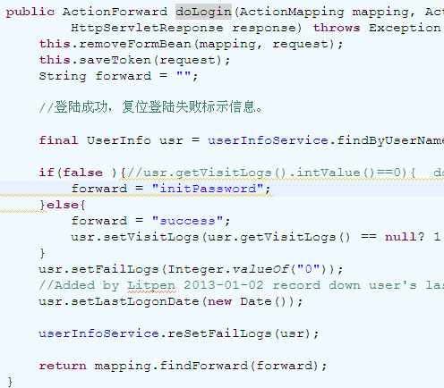
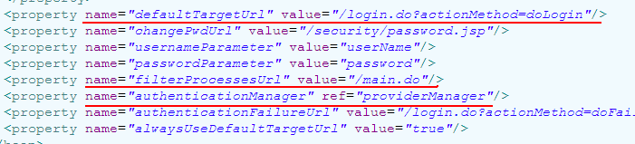
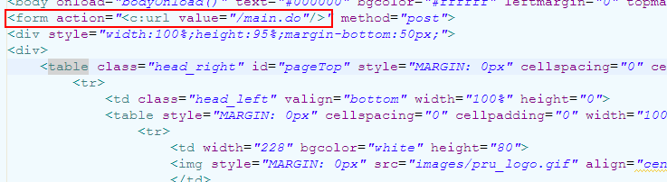
Authentication – Spring Security
appContext_securityContext.xml
LoginAction.java
3
2
4
1
login.jsp
5
/menu.do?actionMethod=init
6
/index.jsp

Slide 63
HttpRequestFilter Chain
web.xml
applicationContext.xml
<filter>
<filter-name>commonWebFilterChain</filter-name>
<filter-class>org.springframework.web.filter.DelegatingFilterProxy</filter-class>
</filter>
<filter-mapping>
<filter-name>commonWebFilterChain</filter-name>
<url-pattern>/*</url-pattern>
</filter-mapping>
<filter>
<filter-name>springSecurityFilterChain</filter-name>
<filter-class>org.springframework.web.filter.DelegatingFilterProxy</filter-class>
</filter>
<filter-mapping>
<filter-name>springSecurityFilterChain</filter-name>
<url-pattern>/*</url-pattern>
</filter-mapping>
…
<servlet>
<servlet-name>struts</servlet-name>
<servlet-class>org.apache.struts.action.ActionServlet</servlet-class>
<init-param>
…
<servlet-mapping>
<servlet-name>struts</servlet-name>
<url-pattern>*.do</url-pattern>
</servlet-mapping>
<bean id="commonWebFilterChain" class="org.springframework.security.util.FilterChainProxy">
<security:filter-chain-map path-type="ant">
<security:filter-chain pattern="/**/ws/*" filters="httpRequestLogFilter,jstlInitFilter" />
<security:filter-chain pattern="/**/*.do" filters="httpRequestLogFilter,jstlInitFilter,securityFilter,checkOnlineOfflineFilter" />
<security:filter-chain pattern="/**/*.jsp" filters="jstlInitFilter" />
</security:filter-chain-map>
</bean>
<!-- changed by litpen 2013-01-26, add the checkOnlineOfflineFilter filter -->
<bean id="checkOnlineOfflineFilter" class="com.pca.claims.common.web.filter.CheckOnlineOfflineFilter">
<property name="batchFrameworkServiceBean" ref="batchJobDetail" />
<property name="strAjaxHdlAction" value="/java2xml.do?actionMethod=convertToXml" />
</bean>
<bean id="jstlInitFilter" class="com.pca.claims.common.web.filter.JstlInitFilter">
<property name="messageSource">
<ref bean="messageSource" />
</property>
</bean>
<bean id="httpRequestLogFilter" class="com.pca.claims.common.web.filter.HttpRequestLogFilter">
<property name ="excludedPath">
<list>
<value>/statusLine.do</value>
</list>
</property>
</bean>

Slide 64
HttpRequestFilter Chain
HttpRequest
httpRequestLogFilter
  2013-03-04 14:36:02,350 INFO [WebContainer : 5] [com.pca.claims.common.web.filter.HttpRequestLogFilter] Before handle the request. The requested uri:/claims/commonSearch.do. actionMethod=doSearch
  {"<script", "<a href", "<img src", "<frame", "<iframe", "<%00script", "https", "http", "<style"}
jstlInitFilter
<bean id="messageSource"
class="org.springframework.context.support.ReloadableResourceBundleMessageSource">
<property name="basenames">
<list>
<value>WEB-INF/classes/ApplicationResources</value>
<value>WEB-INF/resources/GlobalResources</value>
<value>WEB-INF/resources/AccessControl</value>
<value>WEB-INF/resources/ValueList</value>
<value>WEB-INF/resources/ClientDemo</value>
securityFilter
checkOnlineOfflineFilter
springSecurityFilterChain
Struts ActionServlet

Slide 65
Exercise 2
1. Create POJO, OR mapping, and DAO class for this table:
create table family_relationship
(relationship_id int, from_client int, to_client int, relationship_type char)
relationship_type: ‘S’ – Spouse, ‘C’ - Child
2. Change the “Update Client” screen, adding a function to add family members(spouse and child) for the current client. Rules:
a. Spouse and child cannot be put under multiple families.
3. Add a checking rule when deleting a client: Client with family members cannot be deleted.

